Slide 1
SQL Server on the Microsoft Azure Platform SQL Server Ground to Cloud Workshop

Slide 2
Agenda for Module 04
Scenario review – Tailspin Toys Gaming
Introduction to Azure SQL
Azure SQL fundamentals
Networking fundamentals
Migrating to Azure SQL
Demos: Database discovery and assessment

Slide 3
Modernizing the WideWorldImporters Gaming Division
Tailspin Toys Gaming (online gameplay) was acquired by WideWorldImporters
Primarily SQL Server 2008 R2
Founded in 2010, exponential growth since then
Gaming services (VMs/databases) run on rented hardware
Primarily software developers, few infrastructure and database resources
Desire to build more intelligent applications with AI and Machine Learning
What, when, and how can I migrate to the cloud?
Want to leverage new security and performance features in Azure they’ve heard about
Need Service Broker, do not want to rearchitect the solution to use an alternative
Applications need better availability and less downtime

Slide 4

Customer concerns
Looking for comparison of SQL database hosting options in Azure.
What tools can help a evaluate databases against target platforms and identify potential issues?
Can we have network isolation and secure channel access from on-premises?

Slide 5
Introduction to Azure SQL

Slide 6

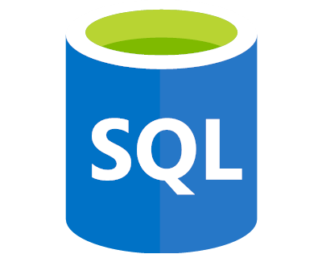
Azure SQL
SQL virtual machines
Managed instances
Databases
Best for migrations and applications requiring OS-level access
Best for most lift-and-shift migrations to the cloud
Best for modern cloud applications. Hyperscale and serverless options are available
SQL virtual machine
Single instance
Single database
Elastic pool
SQL Server and OS server access
Expansive SQL And OS version support
Automated manageability features for SQL Server
SQL Server surface area (vast majority)
Native virtual network support
Fully managed service
Hyperscale storage (up to 100TB)
Serverless compute
Fully managed service
Resource sharing between multiple databases to price optimize
Simplified performance management for multiple databases
Fully managed service

Slide 7



The Allscripts prescription for agility: lift and shift to the cloud
Allscripts is a leading healthcare software manufacturer, serving physician practices, hospitals, health plans, and Big Pharma. To transform its applications frequently and host them securely and reliably, Allscripts has started to use Microsoft Azure. In just three weeks, the company lifted and shifted dozens of acquired applications running on 1,000 virtual machines to Azure with Azure Site Recovery. Allscripts also develops software in Azure and realizes dramatic time-to-market gains and savings by using the Azure platform as a service offering.
Microsoft Azure
Azure Site Recovery
Azure SQL Database
Azure Virtual Machines
Azure Cosmos DB
10,000 employees
Partner professional services
United States
Notes:
https://customers.microsoft.com/en-us/story/allscripts-partner-professional-services-azure

Slide 8
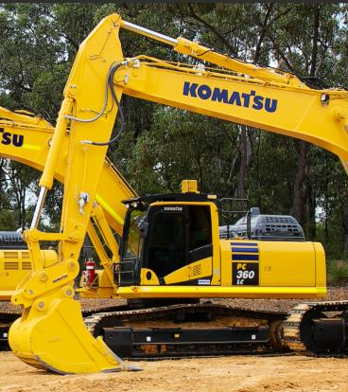
Komatsu achieves breakthrough performance gains and savings with Azure SQL Database Managed Instance
Challenge
Had multiple mainframe applications for different types of data, and needed to consolidate them into a single system so that different parts of the organization can easily get a holistic view of data from different sources
Impact
Moved the entire database and the Discovery Hub analytics implementation to Azure SQL Database Managed Instance in less than two weeks, and since then we’ve seen a 49 percent cost reduction and 25 to 30 percent performance gains.
“We determined Azure SQL Database Managed Instance was the best choice for us in terms of scalability, cost, and performance.… We’ve seen a 49 percent cost reduction and 25 to 30 percent performance gains..”
Nipun Sharma: Analytics Architect, Business Technology and Systems
Komatsu Australia
Notes:
https://customers.microsoft.com/en-us/story/komatsu-australia-manufacturing-azure

Slide 9


AccuWeather weathers the storm with Azure
The company first moved its API business to Azure. AccuWeather sells a host of weather-related APIs that news outlets and other companies plug into their enterprise resource planning, customer relationship management, and other business applications. The company receives more than 40 billion API calls a day for weather information, and Azure provides a more scalable, cost-effective way to manage this service.
Next the company moved its big data storage and processing, using services such as Azure Blob storage, Azure Data Factory, and Azure SQL Database.
When AccuWeather set out to build an automated, scalable weather prediction service for business customers, it turned to Azure as well. To create highly accurate forecasts, Radich’s team needed sophisticated machine learning tools that it could customize using R and Python code.
“With Azure, we have access to sophisticated data science services in a real-time, on-demand basis, which helps us innovate faster.”
- Chris Patti: Chief Technology Officer, AccuWeather
Azure API Management
Azure App Service
Azure Data Factory
Azure Machine Learning
Azure SQL Database
Azure Storage
Medium (50 - 999 employees)
Professional Services
USA
Notes:
https://customers.microsoft.com/en-us/story/accuweather-partner-professional-services-azure

Slide 10


World-class, cloud-enabled time and labor application.
Challenge
Flex Time by Paychex handles 13 million timecards and 3 million distinct punches on any given day for over 650,000 customers. With an increasing volume of customers, however, managing that environment became very cumbersome. Guaranteeing uptime meant constant investments in new hardware, which was both time-consuming and capital-intensive.
Impact
Paychex engineers are freed from managing infrastructure, licensing, and database spin up and spin down. Built-in intelligent features like automatic tuning optimize database performance, leaving them to focus on what they do best: understand how clients are accessing the app and provide value in their continuous delivery pipeline.
“Azure SQL Database allows us to execute upgrades and releases without our customers ever knowing it, which is critical for an application that runs 24/7/365.”
Dave Wilson: Sr. Director of IT Infrastructure and Architecture
Notes:
https://customers.microsoft.com/en-us/story/paychex-azure-sql-database-us

Slide 11

Tailspin Toys – Recommended database
Azure SQL Database Managed Instance
Platform-as-a-Service (PaaS)
Supports database migration from on-premises with minimal to no database changes (i.e. Service Broker)
Provides the benefits of Azure SQL Database but adds capabilities that were previously only available in SQL VMs
Includes a native virtual network (VNet) and near 100% compatibility with on-premises SQL Server
Notes:
Managed instance is a new deployment option of Azure SQL Database, providing near 100% compatibility with the latest SQL Server on-premises (Enterprise Edition) Database Engine.
Provides a native virtual network (VNet) implementation that addresses common security concerns, and a business model favorable for on-premises SQL Server customers.
The managed instance deployment model allows existing SQL Server customers to lift and shift their on-premises applications to the cloud with minimal application and database changes.
At the same time, the managed instance deployment option preserves all PaaS capabilities (automatic patching and version updates, automated backups, high-availability ), that drastically reduces management overhead and TCO.
Adds features that are not available in Azure SQL Database, such as cross-database queries, linked servers, CLR modules, and Service Broker.

Slide 12
Flexible compute, storage & performance options
Simplicity
We remain committed to the DTU-based model and the simplicity it offers customers who want a pre-configured solution
Flexibility:
The vCore-based model reflects our commitment to customer choice and to simplify the hybrid benefit for customers migrating from on-premises
Customers pay for:
Service tier + number of vCores
Type and amount of data storage
Number of IO
Backup storage (RA-GRS)
Service tier | General purpose |  | Business critical |  | Hyperscale
Best for | Most budget-oriented workloads |  | Critical business applications with high IO requirements. |  | VLDB OLTP and HTAP workloads with highly scalable storage and read-scale requirements
Deployment option | Single / Elastic Pools | Managed Instance | Single / Elastic Pools | Managed Instance | Single
Compute tiers | Gen4: 1 to 24 vCore Gen5: 2 to 80 vCore | Gen4: 4 to 24 vCore Gen5: 4 to 80 vCore | Gen4: 1 to 24 vCore Gen5: 2 to 80 vCore | Gen4: 4 to 24 vCore Gen5: 4 to 80 vCore | Gen4: 1 to 24 vCore Gen5: 2 to 80 vCore
Storage | Premium remote |  | Local SSD |  | Local SSD Cache
 | 32GB – 8TB per instance | 32GB – 8TB per instance | 32GB – 4TB per instance | 32GB – 8TB per instance | Scale from 5GB to 100TB of storage in 1GB increments
In-Memory | Not supported |  | Supported |  | Not supported
Read-write IO | ~2ms for all data access |  | <0.5ms for all data access |  | <0.5ms for hot data access ~2ms otherwise
Availability | 2 read replicas |  | 3 replicas, 1 read-scale replica, zone-redundant HA |  | Primary read/write replica + up to 4 read replicas
Backups | RA-GRS, 7-35 days (7 days by default) |  | RA-GRS, 7-35 days (7 days by default) |  | LRS, ZRS, RA-GRS, 7-35 days (7 days by default)
For latest information reference: https://azure.microsoft.com/en-us/pricing/details/sql-database/
Notes:
https://azure.microsoft.com/en-us/pricing/details/sql-database/
Serverless currently falls within GP > Single > Gen5

Slide 13
Flexible compute, storage & performance options
Simplicity
We remain committed to the DTU-based model and the simplicity it offers customers who want a pre-configured solution
Flexibility:
The vCore-based model reflects our commitment to customer choice and to simplify the hybrid benefit for customers migrating from on-premises
Customers pay for:
Service tier + number of vCores
Type and amount of data storage
Number of IO
Backup storage (RA-GRS)
Service tier | General purpose |  | Business critical |  | Hyperscale
Best for | Most budget-oriented workloads |  | Critical business applications with high IO requirements. |  | VLDB OLTP and HTAP workloads with highly scalable storage and read-scale requirements
Deployment option | Single / Elastic Pools | Managed Instance | Single / Elastic Pools | Managed Instance | Single
Compute tiers | Gen4: 1 to 24 vCore Gen5: 2 to 80 vCore | Gen4: 4 to 24 vCore Gen5: 4 to 80 vCore | Gen4: 1 to 24 vCore Gen5: 2 to 80 vCore | Gen4: 4 to 24 vCore Gen5: 4 to 80 vCore | Gen4: 1 to 24 vCore Gen5: 2 to 80 vCore
Storage | Premium remote |  | Local SSD |  | Local SSD Cache
 | 32GB – 8TB per instance | 32GB – 8TB per instance | 32GB – 4TB per instance | 32GB – 8TB per instance | Scale from 5GB to 100TB of storage in 1GB increments
In-Memory | Not supported |  | Supported |  | Not supported
Read-write IO | ~2ms for all data access |  | <0.5ms for all data access |  | <0.5ms for hot data access ~2ms otherwise
Availability | 2 read replicas |  | 3 replicas, 1 read-scale replica, zone-redundant HA |  | Primary read/write replica + up to 4 read replicas
Backups | RA-GRS, 7-35 days (7 days by default) |  | RA-GRS, 7-35 days (7 days by default) |  | LRS, ZRS, RA-GRS, 7-35 days (7 days by default)
For latest information reference: https://azure.microsoft.com/en-us/pricing/details/sql-database/
Notes:
https://azure.microsoft.com/en-us/pricing/details/sql-database/
vCore model so we can get AHB: 1 Enterprise license core = 1 Business Critical core
Business critical because online gaming wants the highest performance and HA
Gen 5 so we can scale our compute more
Also for read-scale replica, zone redundant HA
Zone-redundant storage (ZRS) replicates your data synchronously across three storage clusters in a single region. Each storage cluster is physically separated from the others and is located in its own availability zone (AZ). Each availability zone—and the ZRS cluster within it—is autonomous and includes separate utilities and networking features. A write request to a ZRS storage account returns successfully only after the data is written to all replicas across the three clusters.
When you store your data in a storage account using ZRS replication, you can continue to access and manage your data if an availability zone becomes unavailable. ZRS provides excellent performance and low latency. ZRS offers the same scalability targets as locally redundant storage (LRS).

Slide 14
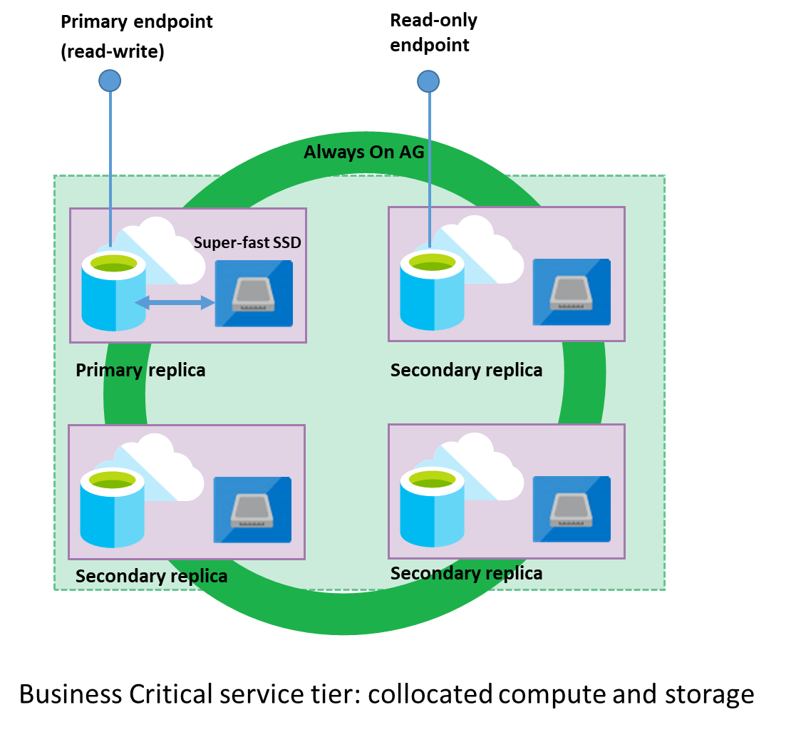
Read-only reporting
Read Scale-out
Read-only replica
Free with SQL MI BC

Slide 15
Azure Hybrid Benefit for SQL Server
License trade-in values
Take an inventory of on-premises licenses to determine potential for conversion
Convert on-premises cores to vCores to maximize value of investments
1 Standard license core = 1 General Purpose or Hyperscale core
1 Enterprise license core = 1 Business Critical core
1 Enterprise license core = 4 General Purpose or Hyperscale cores (virtualization benefit)
SQL Server cores with SA license
vCores on Azure SQL Database
SQL Server Standard Edition
General purpose or Hyperscale vCore
Business critical vCore
SQL Server Enterprise Edition
4x General purpose or Hyperscale vCores
Notes:
SQL Server Enterprise Edition customers can use an unlimited virtualization benefit for their on-premises workloads. However, moving to the cloud to take advantage of its management, flexibility and cost benefits can be cost prohibitive for some heavily virtualized customers. The Azure Hybrid Benefit for SQL Server provides SQL Enterprise Edition customers with Software Assurance the ability to get 4 cores in the cloud for every 1 core they own on-premises for workloads moving to the General Purpose or Hyperscale SKU – the SKU that best meets the requirements for highly virtualized workloads. This makes moving virtualized applications to SQL Database highly cost effective as customers will not have to purchase incremental vCores to move their virtualized application to the cloud.

Slide 16
Azure SQL Fundamentals

Slide 17
Azure SQL Database — Everything built-in
Business continuity
High availability
Automated backups
Long term backup retention
Geo-replication
Scale
Advanced security
Automatic tuning
Built-in monitoring
Built-in intelligence
Notes:
Business continuity enables your business to continue operating in the face of disruption, particularly to its computing infrastructure.
High availability of Azure SQL Database guarantees your databases are up and running 99.99% of the time, no need to worry about maintenance/downtimes.
2 read replicas - GP
3 replicas, 1 read-scale replica, zone-redundant HA - BC
Primary read/write replica + up to 4 read replicas - HS
Automated backups are created and use Azure read-access geo-redundant storage (RA-GRS) to provide geo-redundancy.
Also Point in Time restore
Long term backup retention enables you to store specific full databases for up to 10 years.
Geo-replication by creating readable replicas of your database in the same or different data center (region). You can manually failover to readable replicas
Also Auto-failover groups allows an application to recover in case of a data center outage
Scale by easily adding more resources (CPU, memory, storage) without long provisioning.
Advanced security detects threats and vulnerabilities in your databases and enables you to secure your data.
Automatic tuning analyzes your workload and provides you the recommendations that can optimize performance of your applications by adding indexes, removing unused indexes, and automatically fixing the query plan issues.
Built-in monitoring capabilities enable you to get the insights into performance of your databases and workload, and troubleshoot the performance issues.
Built-in intelligence automatically identifies the potential issues in your workload and provides you the recommendations that can help you to fix the problems.

Slide 18

Azure SQL Database — Everything built-in
Azure SQL VMs
Business continuity
High availability
Automated backups
Long term backup retention
Geo-replication
Scale
Advanced security
Automatic tuning
Built-in monitoring
Built-in intelligence
Notes:
Business continuity enables your business to continue operating in the face of disruption, particularly to its computing infrastructure.
High availability of Azure SQL Database guarantees your databases are up and running 99.99% of the time, no need to worry about maintenance/downtimes.
Automated backups are created and use Azure read-access geo-redundant storage (RA-GRS) to provide geo-redundancy.
Long term backup retention enables you to store specific full databases for up to 10 years.
Geo-replication by creating readable replicas of your database in the same or different data center (region).
Scale by easily adding more resources (CPU, memory, storage) without long provisioning.
Advanced security detects threats and vulnerabilities in your databases and enables you to secure your data.
Automatic tuning analyzes your workload and provides you the recommendations that can optimize performance of your applications by adding indexes, removing unused indexes, and automatically fixing the query plan issues.
Built-in monitoring capabilities enable you to get the insights into performance of your databases and workload, and troubleshoot the performance issues.
Built-in intelligence automatically identifies the potential issues in your workload and provides you the recommendations that can help you to fix the problems.

Slide 19

SQL Server 2019 comparison to Azure SQL
Feature | SQL Server 2019 | Azure SQL
Intelligent Query Processing
Lightweight Query Profiling
In-Memory Database
Always Encrypted with Enclaves
Data Classification
Accelerated Database Recovery
UTF-8
Extensibility Framework
Polybase Data Virtualization
*
*
In-Memory OLTP exists in both SQL Server and Azure

Slide 20
Networking Fundamentals

Slide 21
Networking 101: Azure Virtual Networks
Azure Virtual Network (VNet)
Logically isolated network on Azure
Allows resources to securely communicate with each other, the internet, and on-prem networks.
Scoped to a single region
Segmented into one or more subnets
Subnets: segmentation of VNets to organize and secure resources in discrete sections
VNet Peering: used to connected multiple virtual networks (can be different regions)
VPN Gateway: provides secure connection between Azure VNet and on-prem over the internet
ExpressRoute: provides secure and private connection between Azure and on-prem
Network security group (NSG): Allows or denies inbound traffic to your Azure resources (like a cloud-level firewall for your network)

Slide 22


SQL DB (single/elastic pools) connectivity architecture
CR2
TR 3
GW
Node
Node
mysqldbsrv.database.windows.net
Node
Node
`
CR1
westus1-a.control.database.windows.net
104.44.238.205
1433
GW
GW
proxy
TR22
Node
Node
(1) redirect-find-db
GW
Node
Node
(2) redirect-query
tr22.westus1-a.worker.database.windows.net
13.94.237.158
11000 -11999
Notes:
https://docs.microsoft.com/en-us/azure/sql-database/sql-database-connectivity-architecture
Front end Gateway (1+) and back-end Sql Server hosts database
Talk about why proxy is default from outside azure ? Redirect from inside azure?
Nslookup demo of cr
Wireshark for TR

Slide 23
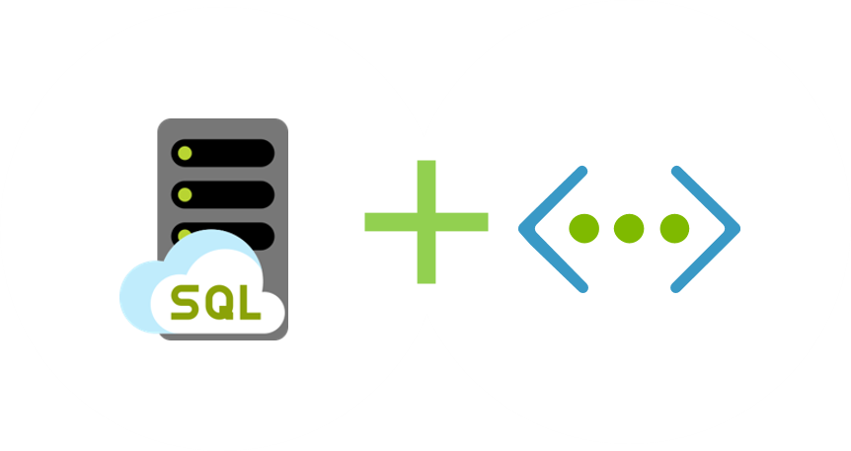
Network isolation
Notes:
SQL MI is deployed into an isolated Vnet
Subnets are used to allow access to SQL MI
On-premises access can be granted through ExpressRoute or a VPN Gateway

Slide 24
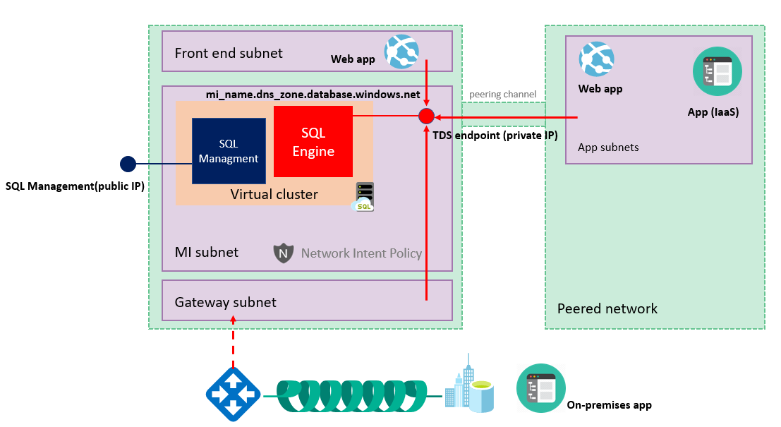
SQL MI connectivity architecture
Notes:
https://docs.microsoft.com/en-us/azure/sql-database/sql-database-managed-instance-connectivity-architecture
SQL MI is deployed into an isolated subnet in a VNet
At a high level, a managed instance is a set of service components. These components are hosted on a dedicated set of isolated virtual machines that run inside the customer's virtual network subnet. These machines form a virtual cluster.
A virtual cluster can host multiple managed instances. If needed, the cluster automatically expands or contracts when the customer changes the number of provisioned instances in the subnet.
Customer applications can connect to managed instances and can query and update databases inside the virtual network, peered virtual network, or network connected by VPN or Azure ExpressRoute. This network must use an endpoint and a private IP address.
Management and deployment services (which run outside the virtual network) connect and manage the managed instance with a management endpoint that maps to an external load balancer. This endpoint is inside the instance's virtual cluster. The management endpoint is protected by a built-in firewall on the network level. Microsoft services and a managed instance (via the management endpoint) connect over the endpoints that have public IP addresses, so when a managed instance creates an outbound connection, it looks like it's coming from this public IP address. Find more information about determining the management endpoint's IP address, traffic, and the built-in firewall here.
Managed instances must be deployed in a dedicated subnet inside the virtual network. There are certain network requirements for the subnet that is to contain a managed instance. You should review and prepare accordingly.

Slide 25
Migrating to Azure SQL

Slide 26
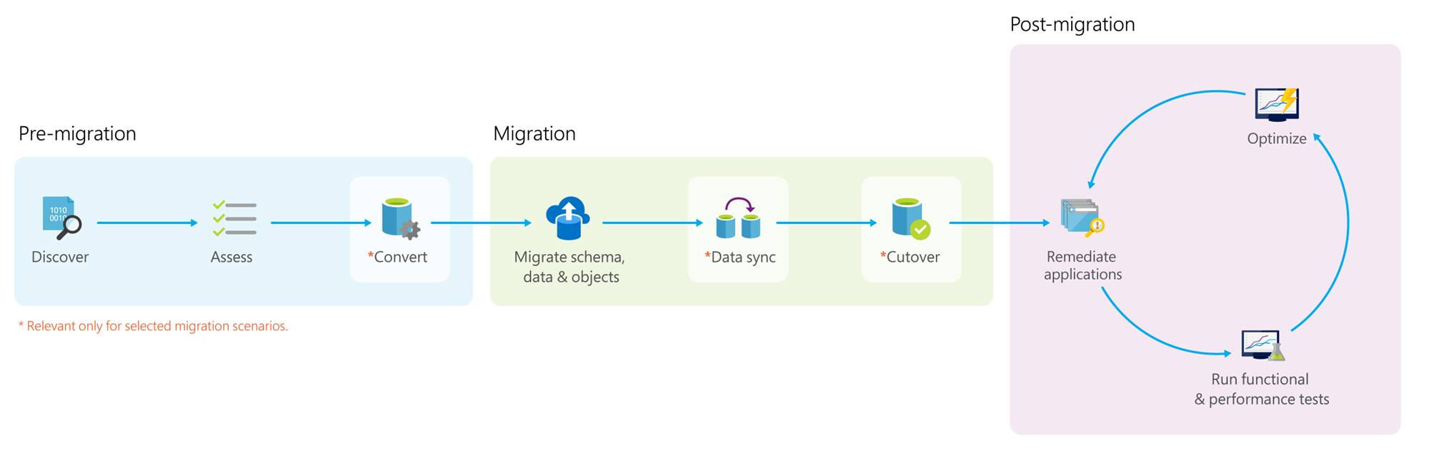
Data migration Process
Notes:
*Pre-migration*:
- **Discover**: Inventory your source database assets and perform an application stack discovery.
- **Assess**: Assess source workloads and fix recommendations.
- **Convert**: Convert the source schema to work in the target environment. This is only relevant for heterogeneous migrations.
*Migration*:
- **Migrate schema, data, and objects**: Migrate the source schema and then migrate the source data to the target.
- **Sync data**: Sync your target schema and data with the source. This is only relevant for minimal-downtime migrations.
- **Cutover**: Cut over from the source to the target environment. This is only relevant for minimal-downtime migrations.
*Post-migration*:
- **Remediate applications**: Iteratively make any necessary changes to your applications.
- **Perform Tests**: Iteratively run functional and performance tests.
- **Optimize**: Based on the tests you performed, address any performance issues and then retest to confirm the performance improvements.

Slide 27
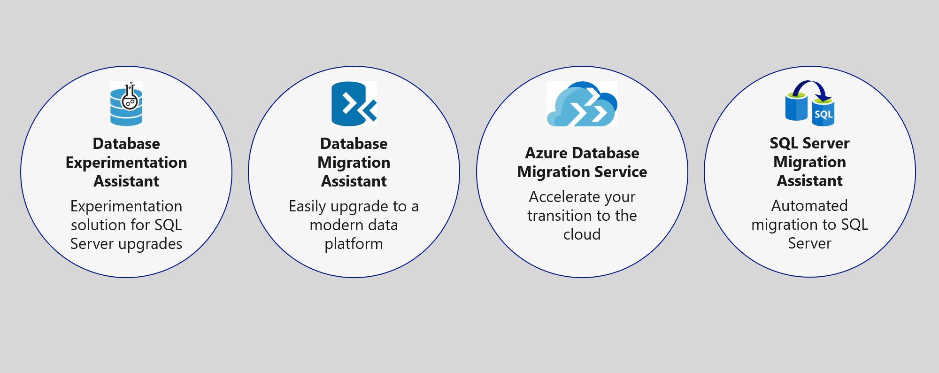
Upgrade & migration tools
NEW
Azure Migrate + DMS + DMA
Notes:
The Azure SQL data platform consists of three options:
SQL Server on an Azure VM
Azure SQL Database Managed Instance
Azure SQL Database
Each of the options will be discussed in more detail in the slides that follow.

Slide 28
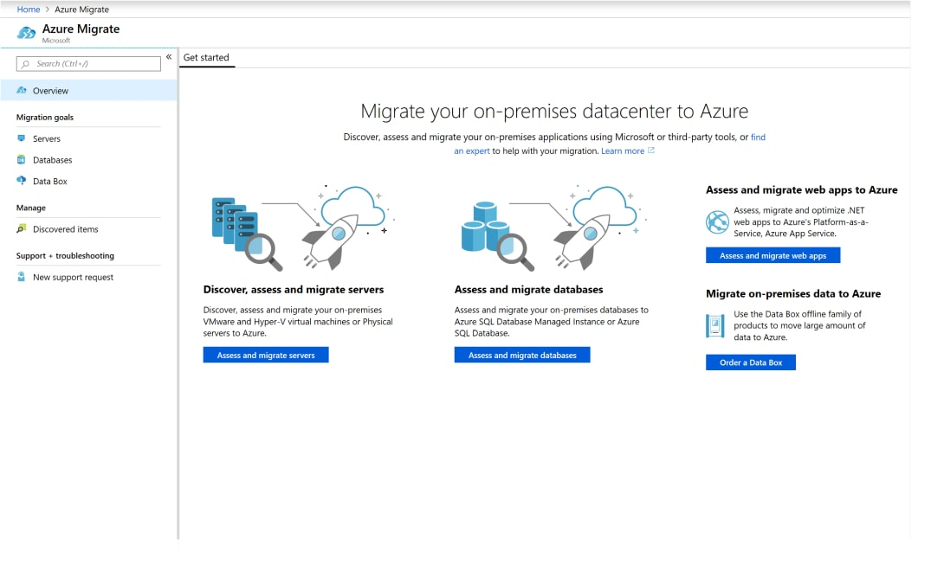
Azure Migrate

Slide 29
Azure Migration Program (AMP)
Available to all Azure customers, scaled through specialized migration partners
Best practice guidance
Offers and incentives
Technical skill building
Infrastructure and data foundations
Migration planning and execution
Digital resources
Migration
Tools
Azure trainers
FastTrack for Azure engineers
Specialized partners
Reduce cost and risk | Accelerate migration velocity | Deliver customer success
Learn more | Azure.com/AMP
Notes:
The Azure Migration Program gives you prescriptive guidance for a step by step approach to cloud migration. AMP offers the opportunity to work closely with Microsoft experts and specialized migration partners to simplify and accelerate your migration.
The program delivers:
Technical skill building to ensure your organization can successfully adopt Azure
Best practices for a step by step approach from start to finish
Azure engineering support for data and infrastructure foundations
Expert guidance from specialized migration partners
Free Azure tools to help you efficiently execute migrations
And cost effective offers to help you save money before, during, and after migration

Slide 30


Preferred migration solution
Azure Migrate
Data Migration Assistant
Azure Database Migration Service
Azure Site Recovery
Partner or Azure Migrate Program engagement
Azure Hybrid Benefit
Prepay for Reserved Capacity
Notes:
Cost minimization
Azure Hybrid Benefit
Reserved capacity payments
DMS
3 month timeframe
DMS
ASR
AMP
Partner engagement
Dedicated resources

Slide 31
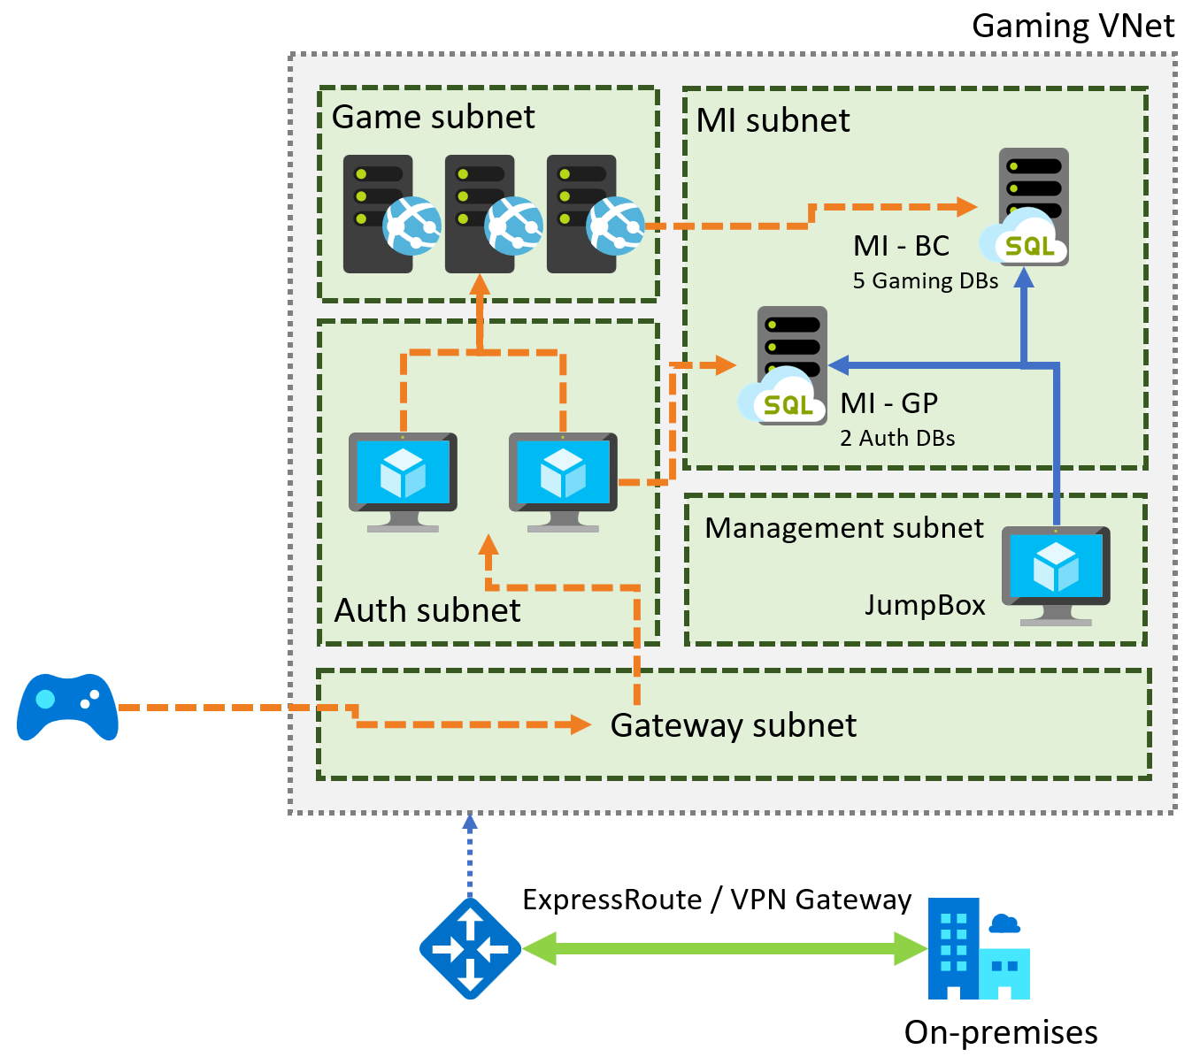
Preferred solution – Gaming services
Notes:
Diagram of the preferred solution for the gaming services. The gaming services are hosted in a VNet, with subnets for MI, Game, Management, Auth, and a Gateway subnet. SQL MI instances are hosted in the MI subnet. Gaming IaaS VMs are hosted in the Game subnet. Authorization VMs are in the Auth subnet, and a JumpBox is in the Management subnet. On-premises resources can access the VNet through ExpressRoute or a VPN gateway.

Slide 32
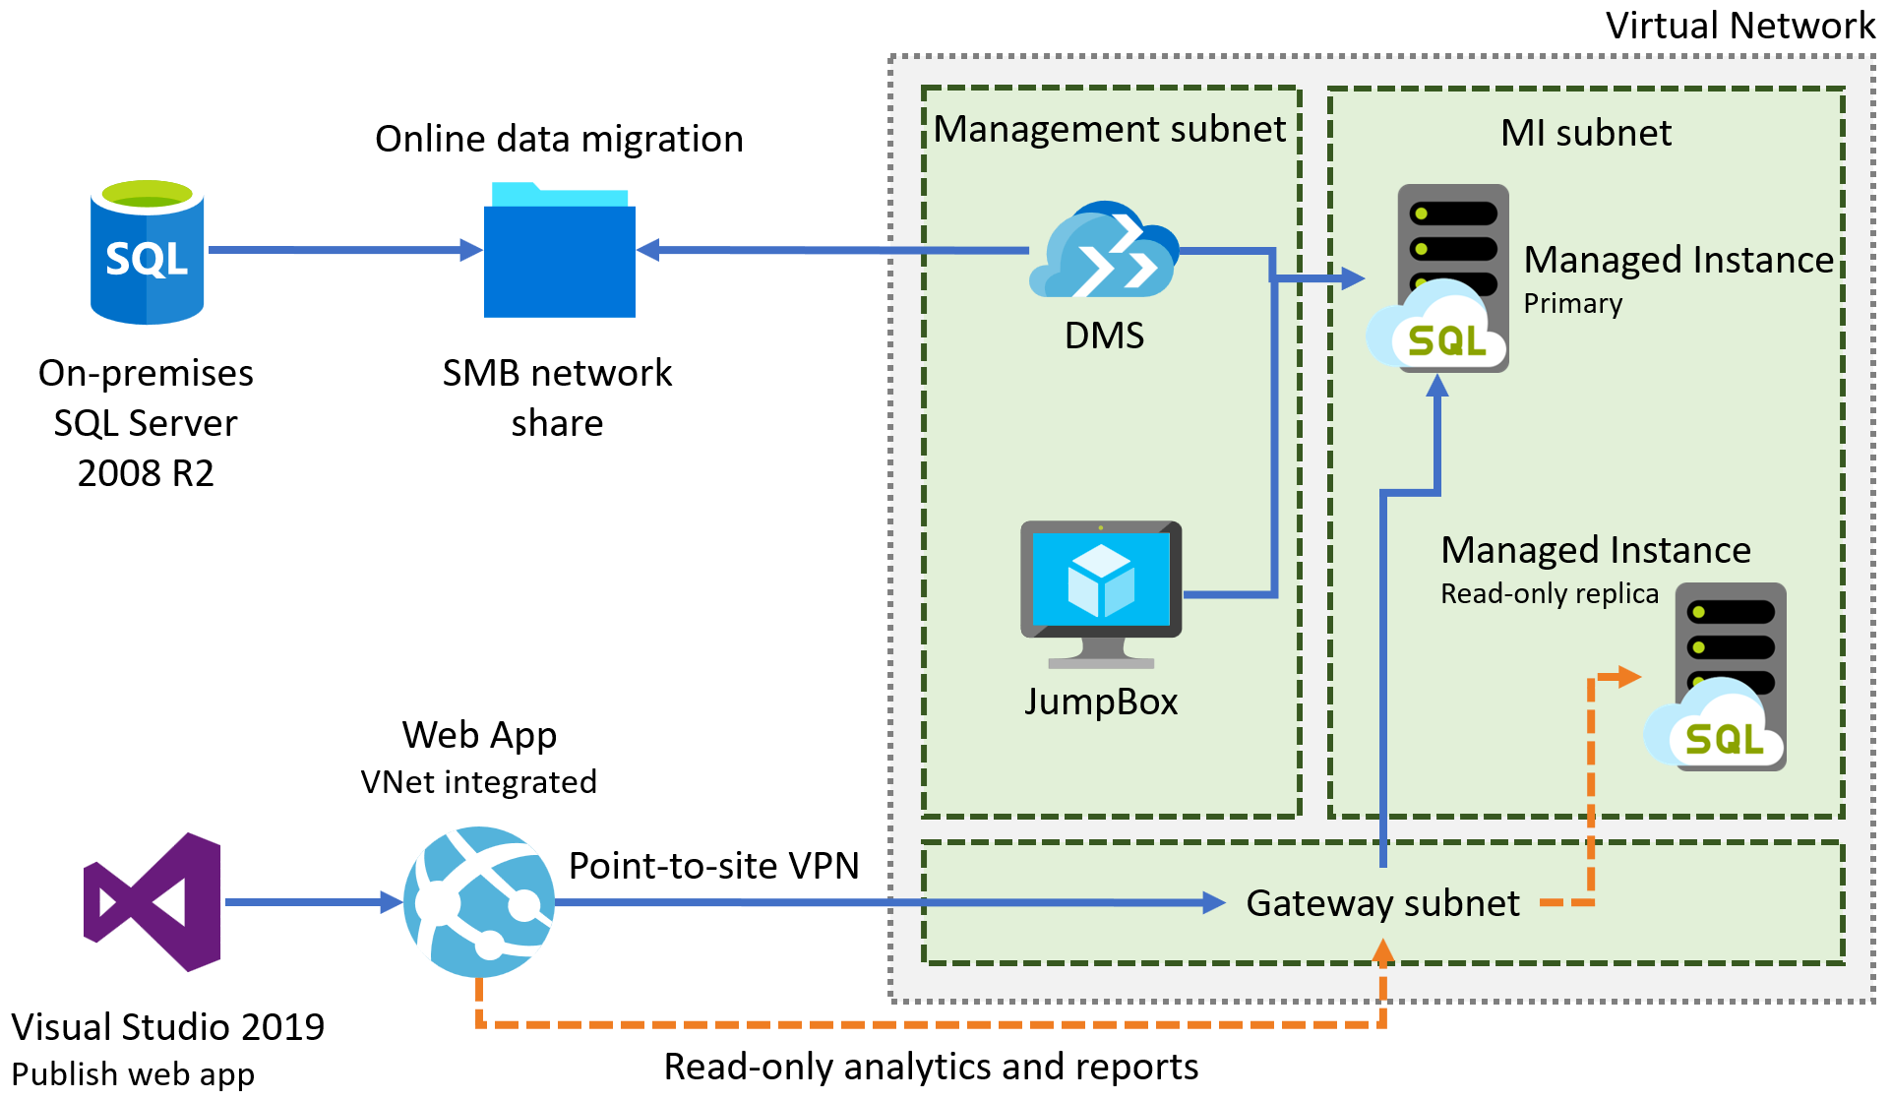
PoC – Gaming services
Notes:
Diagram of the preferred solution for the gaming services. The gaming services are hosted in a VNet, with subnets for MI, Game, Management, Auth, and a Gateway subnet. SQL MI instances are hosted in the MI subnet. Gaming IaaS VMs are hosted in the Game subnet. Authorization VMs are in the Auth subnet, and a JumpBox is in the Management subnet. On-premises resources can access the VNet through ExpressRoute or a VPN gateway.

Slide 33
Demo: Database Discovery and Assessment

Slide 34


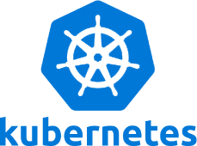
What you will learn in this workshop
Feature exists in Azure SQL Database
Connect to Azure SQL Database
Gain Performance with no application changes
Intelligent Query Processing
Need to classify and audit your data?
Data Classification and Auditing
Long running transactions affect your availability
Accelerated Database Recovery
Want external access with no data movement?
Data Virtualization
Is SQL Server on Linux and Containers compatible?
SQL Server Replication in one command
Each of these are independent modules
Want slides to learn more?
https://aka.ms/bobwardms
https://github.com/microsoft/sqlworkshops/tree/master/sql2019lab/slides

Slide 35
Learn more
http://aka.ms/annalytics
twitter: @AnalyticAnna
Use our free training at https://aka.ms/sqlworkshops
Learn from videos and demos at https://aka.ms/sqldbonyoutube
Download and try it at http://aka.ms/ss19
What’s new for SQL 2019 documentation
Sign-up for the EAP program at https://aka.ms/eapsignup

Slide 36
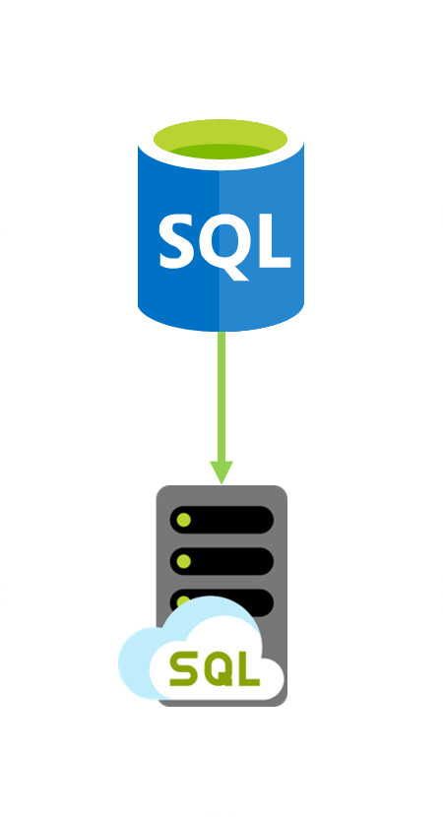
Customer situation
Tailspin Toys is online gaming company experiencing exponential growth
Struggling to manage expanding database infrastructure
Lacking ability to scale
Looking to migrate gaming services to the cloud

Slide 37
Preferred solution – Gaming services
Azure Site Recovery to migrate VMs
Multi-region deployments to address latency
VM scale sets for scalability of VMs
Availability Zones for high-availability
Availability Zones for VMs
Auto-failover groups in SQL MI (in public preview)
Geo-restore and geo-replication
Notes:
NOTE: Auto-failover groups for Managed Instance is currently in public preview. For customers who object to using a preview feature, a manual failover process would need to be implemented. This could involve setting up transactional replication to another SQL MI in a different region. VNet peering would need to be established between the virtual networks.

Slide 38
Preferred solution – Regional outages

Slide 39
Network isolation
Notes:
SQL MI is deployed into an isolated Vnet
Subnets are used to allow access to SQL MI
On-premises access can be granted through ExpressRoute or a VPN Gateway

Slide 40
Cloud vendor lock-in
PaaS database services can be used
Use transactional replication to move data out

Slide 41
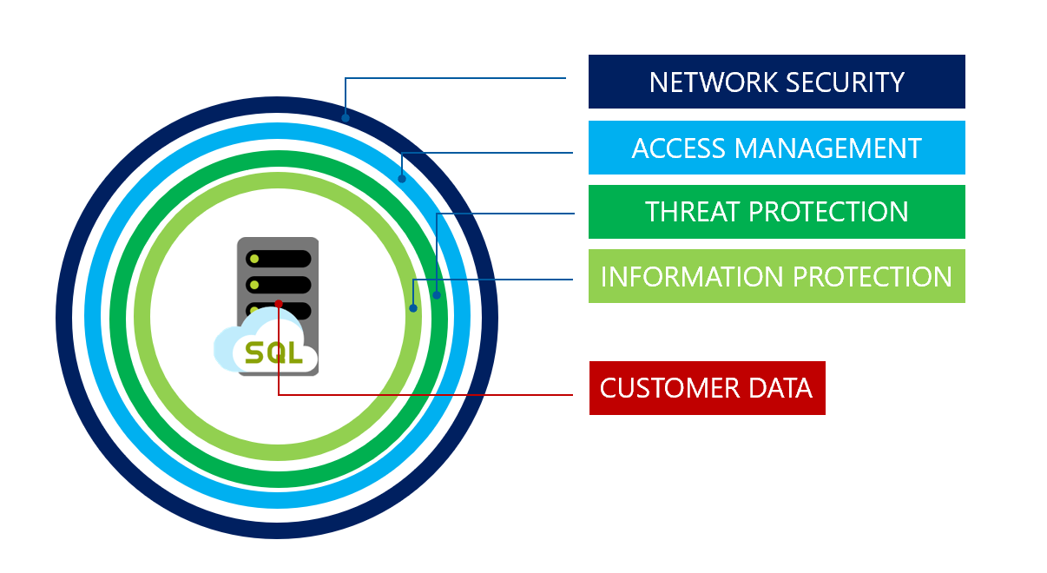
Preferred solution – Database security
Notes:
SQL MI includes numerous security tools that could be leveraged by Tailspin Toys, including:
SQL Database Advance Data Security
SQL Data Discovery and Classification
SQL Vulnerability Assessment service
Advanced Threat Detection
Transparent Data Encryption
Dynamic Data Masking
Row-level security

Slide 42
Customer situation
Tailspin Toys is online gaming company experiencing exponential growth
Struggling to manage expanding database infrastructure
Lacking ability to scale
Looking to migrate gaming services to the cloud

Slide 43
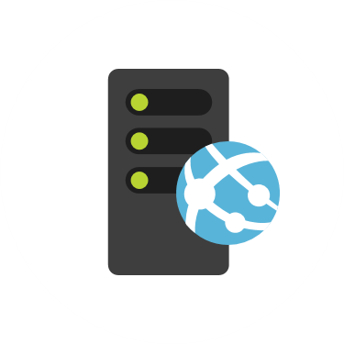
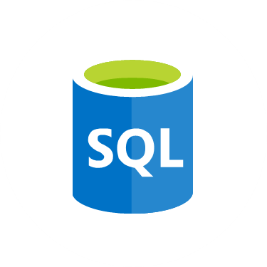
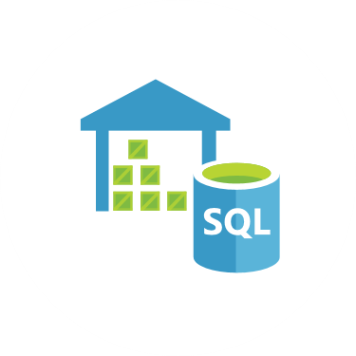
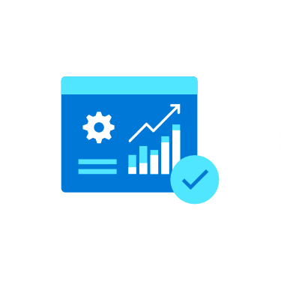
Customer situation
Gaming
Service
VMs
SQL 2008
Databases
Data
Warehouse
Reports
Notes:
Gaming services and authentication VMs
Lift-and-shift
Gaming databases
SQL Server 2008 R2
Looking at PaaS if possible
Running Service broker feature
Data warehouse
SQL Server 2008 R2
Lots of reports
Direct connections by developers and customer service
Data fed via SSIS jobs, hourly
Reports
SSAS cubes feed reports
SSRS reports
Sent to SharePoint

Slide 44
Customer objections
Looking for comparison of SQL database hosting options in Azure.
What tools can help a evaluate databases against target platforms and identify potential issues?
Can we have network isolation and secure channel access from on-premises?
Don’t want to be locked into a cloud vendor.

Slide 45


Preferred solution
Azure Hybrid Benefit
Prepay for reserved capacity
Azure Database Migration Service
Azure Site Recovery
Partner engagement
Notes:
Cost minimization
Azure Hybrid Benefit
Reserved capacity payments
DMS
3 month timeframe
DMS
ASR
Partner engagement
Dedicated resources

Slide 46
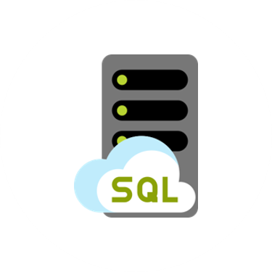

Preferred solution - PoC
Gaming
Service
VMs
SQL MI
Databases
SQL DB
Hyperscale
Data
Warehouse
Power BI
Reports
Notes:
Gaming services and authentication VMs for 1 game
Gaming and auth databases
SQL MI Business critical for games, and GP for auth
Data warehouse
SQL DB Hyperscale
ADF to replace SSIS packages
Reports
Azure Analysis Services
Power BI

Slide 47
Preferred solution – IaaS vs PaaS
Cost
Administration
SLAs
Time to move

Slide 48
Preferred solution – Recommended database
Azure SQL Database Managed Instance
Platform-as-a-Service (PaaS)
Supports database migration from on-premises with minimal to no database changes
Provides all of the PaaS benefits of Azure SQL Database but adds capabilities that were previously only available in SQL VMs
Includes a native virtual network (VNet) and near 100% compatibility with on-premises SQL Server
Notes:
Managed instance is a new deployment option of Azure SQL Database, providing near 100% compatibility with the latest SQL Server on-premises (Enterprise Edition) Database Engine.
Provides a native virtual network (VNet) implementation that addresses common security concerns, and a business model favorable for on-premises SQL Server customers.
The managed instance deployment model allows existing SQL Server customers to lift and shift their on-premises applications to the cloud with minimal application and database changes.
At the same time, the managed instance deployment option preserves all PaaS capabilities (automatic patching and version updates, automated backups, high-availability ), that drastically reduces management overhead and TCO.
Adds features that are not available in Azure SQL Database, such as cross-database queries, linked servers, CLR modules, and Service Broker.

Slide 49
Preferred solution – Data migration
Notes:
*Pre-migration*:
- **Discover**: Inventory your source database assets and perform an application stack discovery.
- **Assess**: Assess source workloads and fix recommendations.
- **Convert**: Convert the source schema to work in the target environment. This is only relevant for heterogeneous migrations.
*Migration*:
- **Migrate schema, data, and objects**: Migrate the source schema and then migrate the source data to the target.
- **Sync data**: Sync your target schema and data with the source. This is only relevant for minimal-downtime migrations.
- **Cutover**: Cut over from the source to the target environment. This is only relevant for minimal-downtime migrations.
*Post-migration*:
- **Remediate applications**: Iteratively make any necessary changes to your applications.
- **Perform Tests**: Iteratively run functional and performance tests.
- **Optimize**: Based on the tests you performed, address any performance issues and then retest to confirm the performance improvements.

Slide 50
Preferred solution – Database security
Notes:
SQL MI includes numerous security tools that could be leveraged by Tailspin Toys, including:
SQL Database Advance Data Security
SQL Data Discovery and Classification
SQL Vulnerability Assessment service
Advanced Threat Detection
Transparent Data Encryption
Dynamic Data Masking
Row-level security

Slide 51
Preferred solution – Read-only reporting
Read Scale-out
Read-only replica
Free with SQL MI BC

Slide 52
Preferred solution – Gaming services
Notes:
Diagram of the preferred solution for the gaming services. The gaming services are hosted in a VNet, with subnets for MI, Game, Management, Auth, and a Gateway subnet. SQL MI instances are hosted in the MI subnet. Gaming IaaS VMs are hosted in the Game subnet. Authorization VMs are in the Auth subnet, and a JumpBox is in the Management subnet. On-premises resources can access the VNet through ExpressRoute or a VPN gateway.

Slide 53
Preferred solution – Gaming services
Azure Site Recovery to migrate VMs
Multi-region deployments to address latency
VM scale sets for scalability of VMs
Availability Zones for high-availability

Slide 54
Preferred solution – Regional outages
Availability Zones for VMs
Auto-failover groups in SQL MI (in public preview)
Geo-restore and geo-replication for DW
Notes:
NOTE: Auto-failover groups for Managed Instance is currently in public preview. For customers who object to using a preview feature, a manual failover process would need to be implemented. This could involve setting up transactional replication to another SQL MI in a different region. VNet peering would need to be established between the virtual networks.

Slide 55
Upgrade & migration tools
Notes:
The Azure SQL data platform consists of three options:
SQL Server on an Azure VM
Azure SQL Database Managed Instance
Azure SQL Database
Each of the options will be discussed in more detail in the slides that follow.

Slide 56
Network isolation
Notes:
SQL MI is deployed into an isolated Vnet
Subnets are used to allow access to SQL MI
On-premises access can be granted through ExpressRoute or a VPN Gateway

Slide 57
Cloud vendor lock-in
PaaS database services can be used
Use transactional replication to move data out

